Slide 1
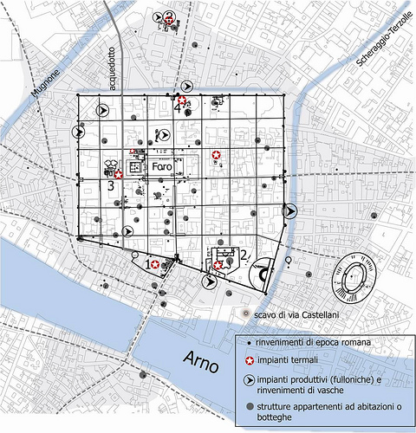
ROMAN HOUSE
Classe 1G sez.BB.CC. 2019-2020
FLORENTIA
Francesco Micillo
Letizia Grementieri
Melissa Beleraj

Slide 2
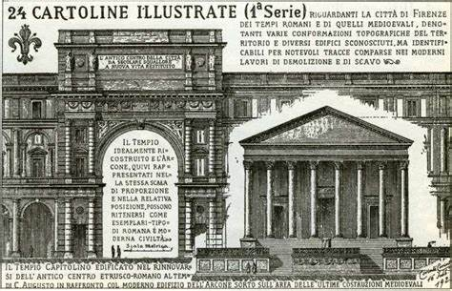
ROMAN HOUSE
Corinti’s illustrations show what Florence was like in Roman times.
Some of them represent the reconstructions of three Roman homes which are located in the area between the Baptistery, San Giovanni square and the Bigallo Arcade.
La Firenze romana è stata soggetto delle cartoline illustrate che Corinto Corinti (1841-1930) realizzò durante i lavori a seguito di Firenze capitale, in cui furono rinvenuti molti resti dell’antica età romana fiorentina.

Slide 3
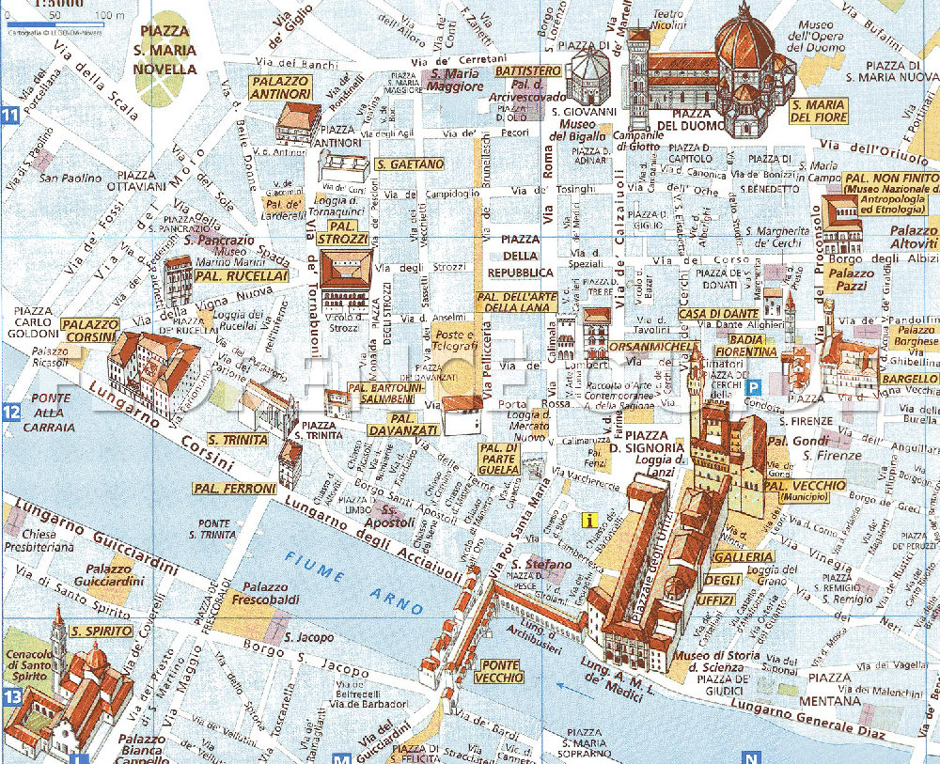

Slide 4
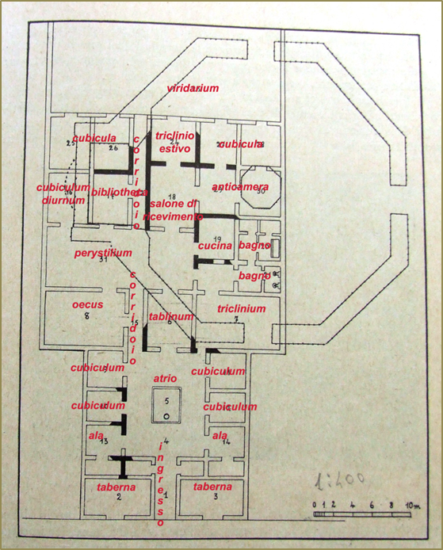
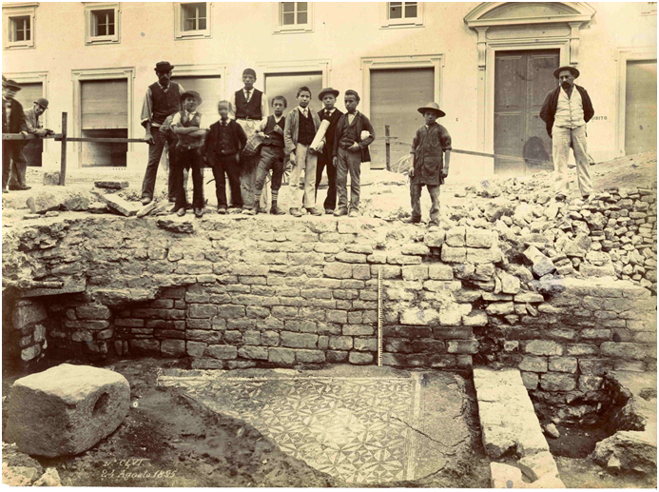
In una foto d’epoca si vede lo scavo della domus rinvenuta nella zona del Battistero e a
fianco la pianta della domus

Slide 5
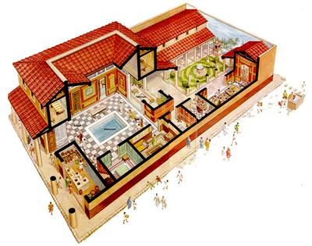
THE INSIDE OF
A ROMAN HOUSE

Slide 6
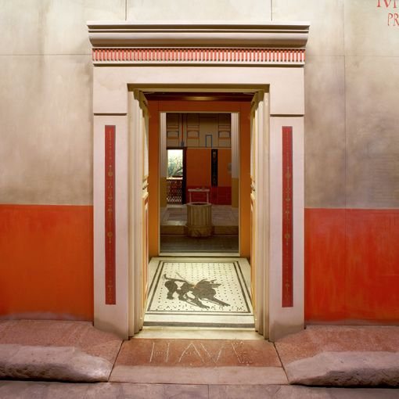
VESTIBULUM
The vestibule was the entrance of the Roman house which opened onto the main street. It wasn’t really spacious, its walls were decorated with paintings and the floor with mosaics which often had a propitiatory meaning. For example there were inscribed
Latin phrases like
“Ave fortunam” or
“Cave canem”

Slide 7
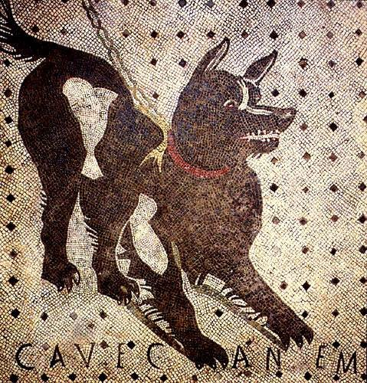

Slide 8
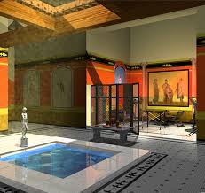
ATRIUM
The atrium was located at the center of the house around which all the other rooms were built.
In the atrium you could find altars dedicated to ancestors and a fire around which daily life took place. The word atrium comes from the Latin word “ater” which means black, a result of the soot that blackened the walls. This space gave light and air to the house because there weren’t any windows. This was thanks to an opening in the roof: the rain water was collected in a central shallow pool called impluvium.

Slide 9
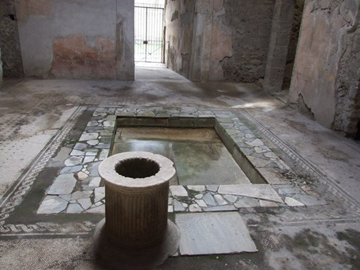
Pompei, Casa del poeta tragico, impluvium

Slide 10
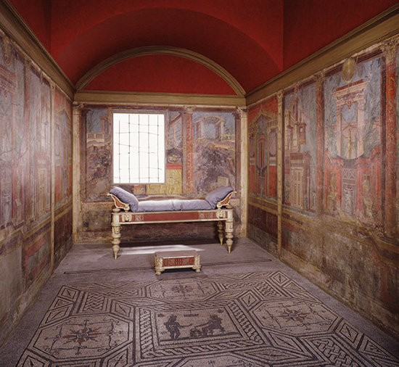
CUBICULA
Cubiculas were small rooms intended as bedrooms without any windows. Their walls were painted and the floors had mosaics, plus sometimes there was an outline where the bed would be placed.

Slide 11
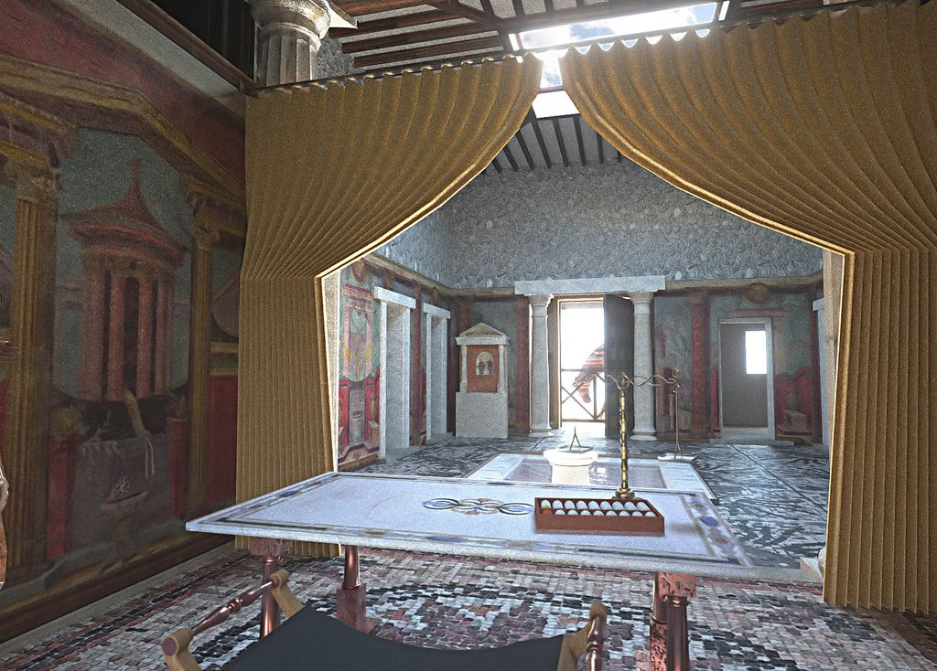
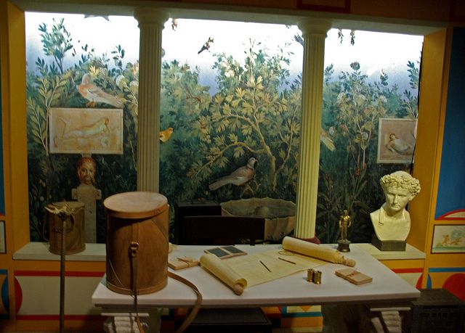
TABLINUM
The tablinum was a big open living room separated from the atrium
with a curtain
It was used by the pater familias who received visitors and kept family documents and managed business there.

Slide 12
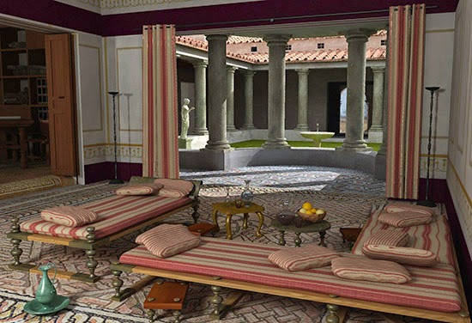
TRICLINIUM
The triclinium was the room where the family consumed their main meal, dinner. Usually this place had three beds on which Romans laid while eating. The left bed was for the host, his wife and his children, the furthest was taken up by important guests and the third one was for other guests.

Slide 13
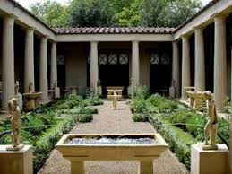
PERISTILIUM
”Peristilium” is a word used to talk about a circular space, marked by surrounding columns, which is inside the house. It was a colonnade and it was often decorated with paintings and mosaics. Inside the portico were placed plants, flowers, fountains and pools. From this type of architecture comes the cloister of abbeys and monasteries.

Slide 14
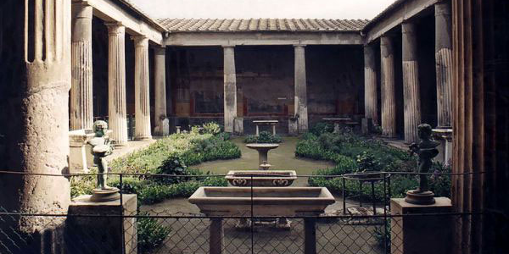
Pompei, Casa dei Vettii, peristilium

Slide 15
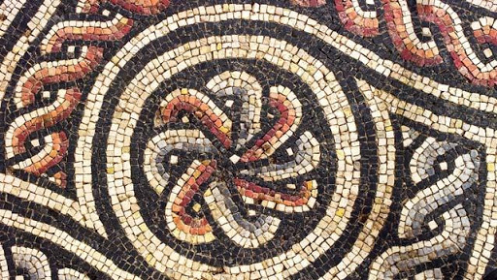
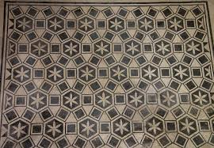
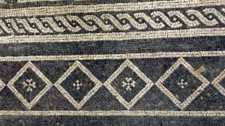
FLOORING
Flooring was really important in a Roman house. It changed in every room and was part of the space’s design. The floors were glazed. The patterns and the friezes were the demonstration of the opulence of the dwelling. The floors were made out of a type of earthenware, terracotta tiles or marble, which were called Sectilia.

