Slide 1
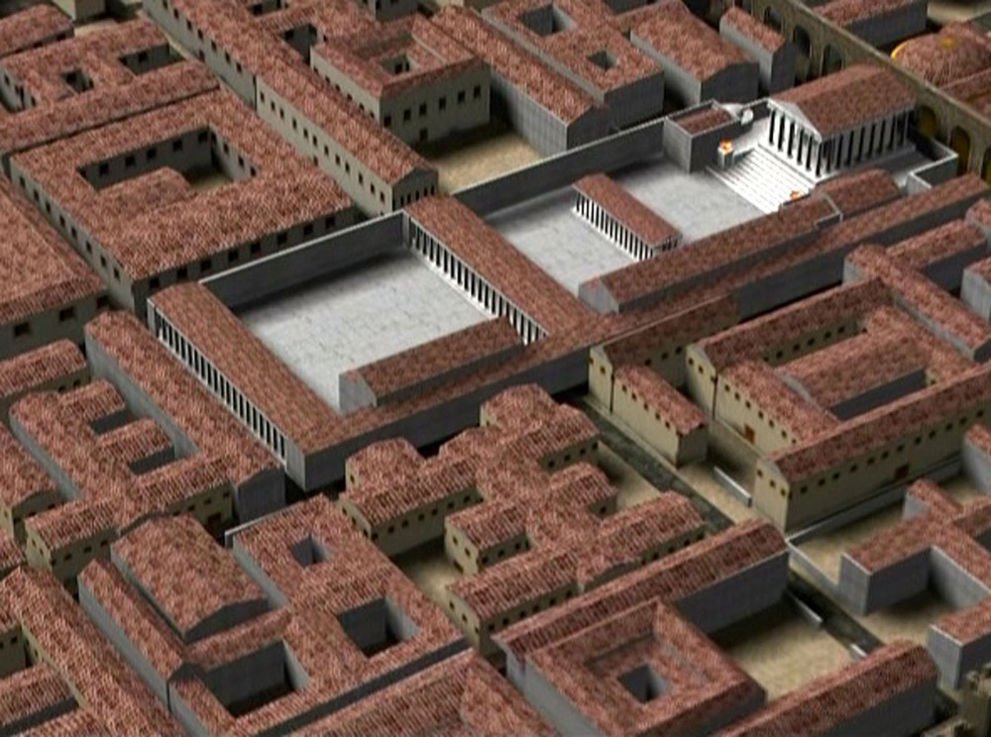
FLORENTIA
Classe 1G sez.BB.CC. 2019-2020
THE FORUM
Arianna Baraghini
Erin Cherici
Matilde Morini
Nora Pacini

Slide 2
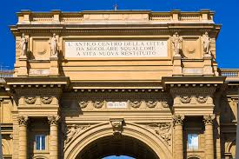
THE CAPITOLINE TEMPLE
“L’antico centro della città da secolare squallore a vita nuova restituito”
This is the inscription that appears on the arch overlooking Piazza della Repubblica. The arch, which was built in the 19th century, rises where the wonderful Capitoline temple used to be located. The phrase refers to the Roman town dating back to the first century BC and arising between the oldest urban settlement of Florence and its walls and internal structures. However, the inhabitants of Fiesole had already been moving towards the flat land for centuries, especially towards the riverbanks of the Arno, which represented an invaluable resource for the populations of the time.

Slide 3
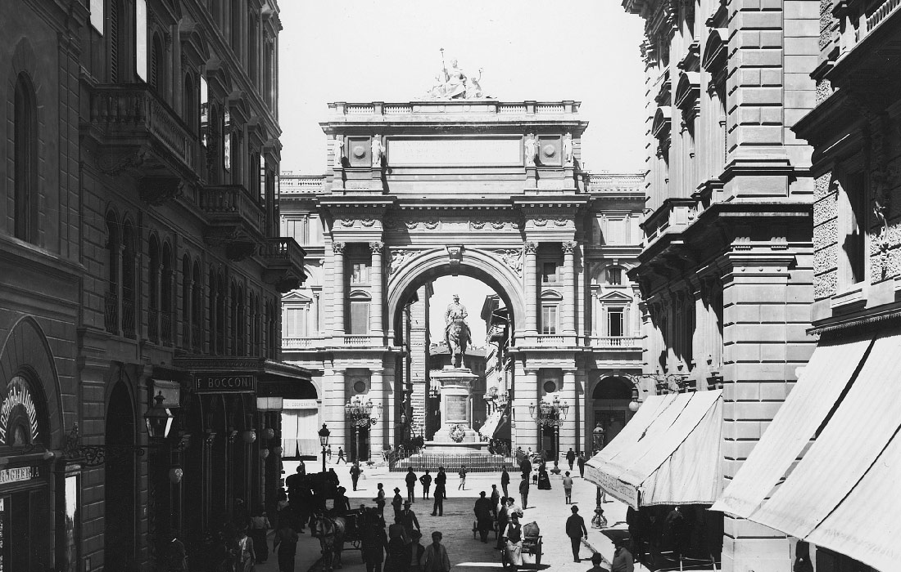
Una foto d’epoca quando ancora in piazza della Repubblica c’era il Monumento equestre a re Vittorio Emanuele (1890)
ora alle Cascine

Slide 4
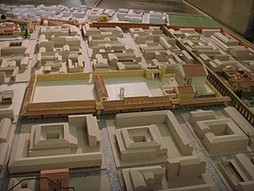
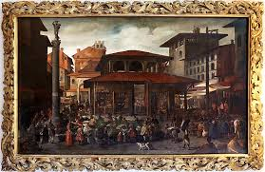
THE FORUM
Covering an area of 92x41 square meters, the forum used to lie in the current “Piazza della Repubblica” and it was circumscribed by today’s streets Calimara, Brunelleschi, Pellicceria and Roma. What we now call ‘via Roma’ was also one of the two perpendicular avenues dividing the city into four sections. Nowadays this street only features modern buildings because in the 19th century some renovation altered its looks. The square itself was used as a popular market until the late 1800s.
Veduta seicentesca del mercato vecchio di Firenze con la Colonna dell’Abbondanza

Slide 5
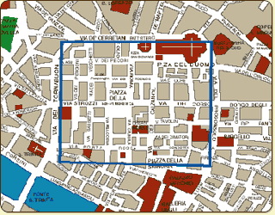
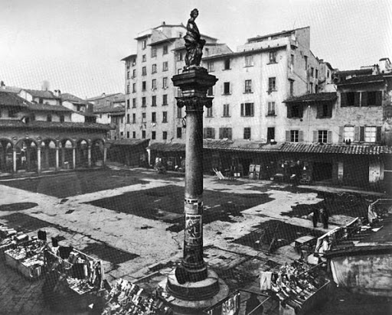
THE FORUM AND THE CAPITOLINE
The Forum was built according to the quadrilateral scheme of the castrum, whose cardo started from the current Piazza San Giovanni and continued down via Roma and via Calimala, while its decumanus ran along via del Corso, via degli Speziali and via Strozzi. The city forum, therefore, opened at the intersection of these two avenues and the capitol was built within that area. Inside it, the simplest daily actions and most of the public life of the Roman city took place; buildings and houses surrounded the Forum, which represented both the physical and the social center of the city. The forum, however, underwent severe changes after the fall of the empire. Over the middle ages the most famous Florentine families flourished and their buildings took the place of the ancient Roman fortresses. What is left of the ancient forum is only the sacrificial column in the center of the square, but in 1431 it was replaced by the column of Wealth

Slide 6
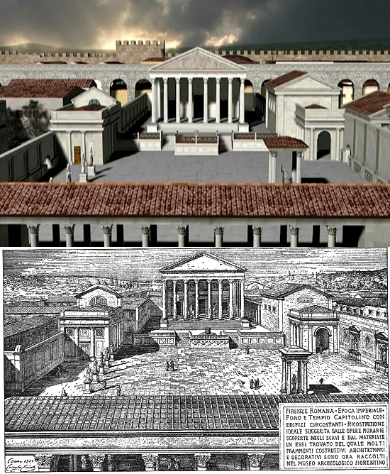
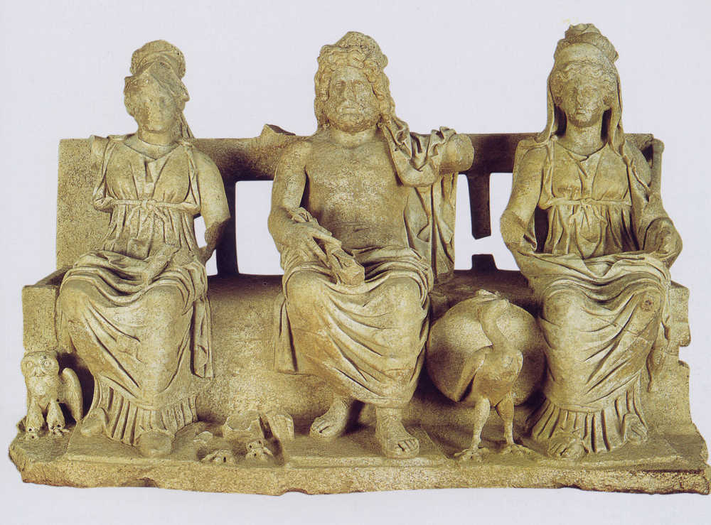
THE CAPITOL AREA
This illustration made by Corinto Corinzi (1841-1930) represents the ancient forum of Florence. Because of the small dimensions of the city, from the forum itself it was possible to see the countryside all around it. A large portico surrounded the four sides of the main square and near it there were the Italic tombs and a bath pool. The most imposing monument was the Capitol, the principal temple dedicated to the divine triad: Jupiter, Minerva and Juno.

Slide 7
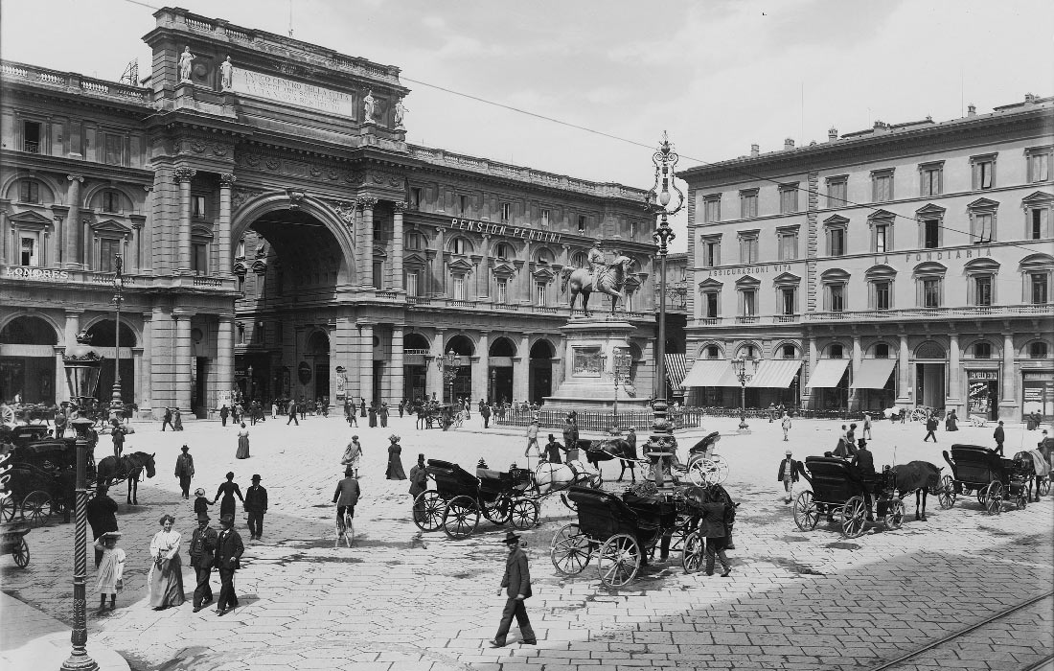
With the advent of Christianity the temple became first a church and then a tavern, but when the forum underwent renovation works in the late 1800s it was destroyed.
When Florence was made the capital of Italy, its centre was restyled and the names of the streets were changed. For example “Via degli Zuffanelli” was renamed “Via del Campidoglio”. This part of the city is now known as “Piazza della Repubblica”

Slide 8
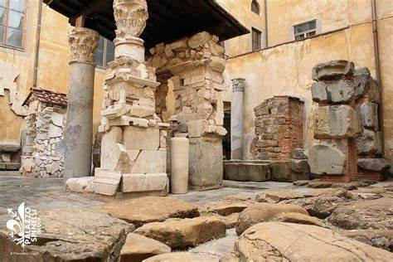
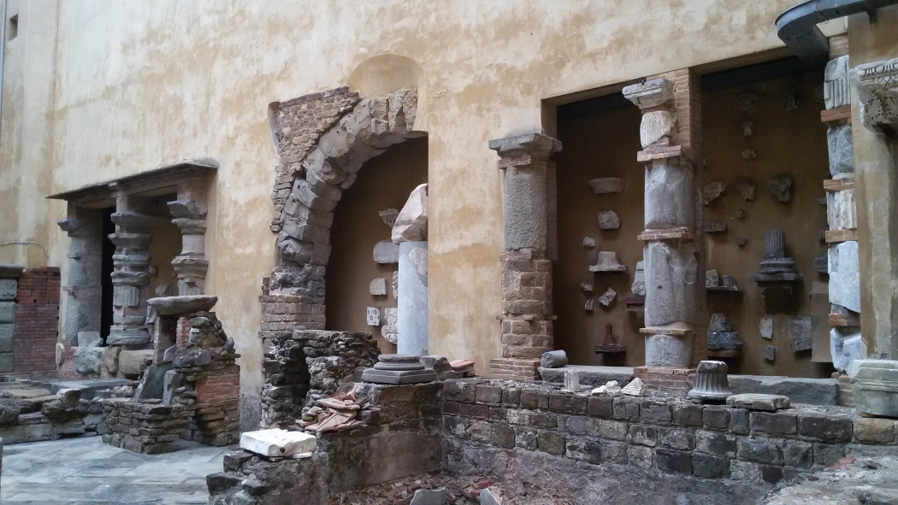
I resti del Foro romano conservati nel Cortile dei Fiorentini del Museo Archeologico Nazionale di Firenze

